Slide 1
오티스엘리베이터 안전문화
Otis Elevator Korea
OTIS PROPRIETARY AND CONFIDENTIAL.

Slide 2
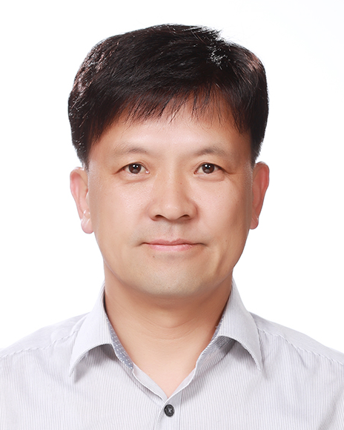
강사 소개
성명 : 최태홍 상무 (Terry Choi)
회사 : 오티스엘리베이터 / 안전
자녀 : 은서(딸), 준서(아들)
입사 년도 : 1993
LG 7 년 / Otis 22 년
안전업무 2015 ~
서울 과학 기술대학교– 안전공학과
한양대학원 – SPM MBA
자전거 / 골프
Terry.choi@otis.com
+8210 5774 5728
OTIS PROPRIETARY AND CONFIDENTIAL.

Slide 3
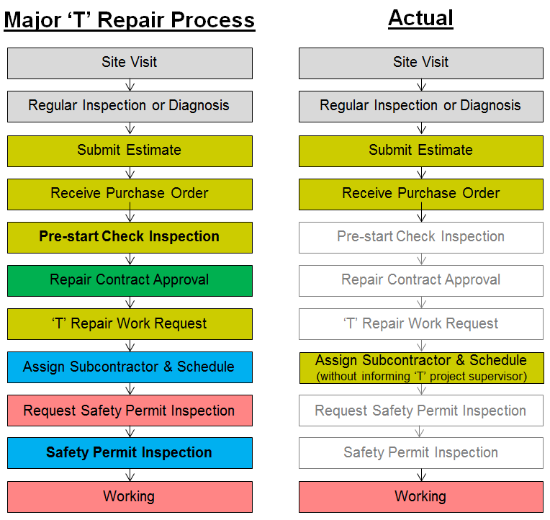
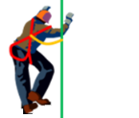
안전문화의 변화
“zero” fatality for 8 years
21
22
Pre-start check completion rate: 60%
Safety permit : 100%
- at job sites : 21%, by phone : 79%
AR Score : 54%
Elevator #3
Normal
Running
Elevator #4
Rope
replace
OTIS PROPRIETARY AND CONFIDENTIAL.

Slide 4
안전 성숙도
본능에 의존
관리에 의존
사고율
개인에 의존
팀에 의존
반응적인 단계
의존적인 단계
독립적인 단계
상호 보완적인 단계
본능에 따른 안전관리
규제 대응에 급급
안전은 안전팀 책임 인식
경영층은 안전에 관심 없음
안전에 경영층 참여 시작
강압적 분위기 및 징계 중심
안전수칙 및 절차 중심
안전이 고용의 조건
안전감사 및 교육이 중요한 수단
작업자의 충분한 안전 지식, 의지
안전 준수행동
안전 = 가치 (개인)
본인 스스로 안전을 지킴 = 가족
안전한 습관
동지애
상호 보살핌
규칙 준수의 상호지원
안전 관련 팀웍
안전 = 가치 (조직)
무의식적불안전
의식적 불안전
의식적 안전
무의식적 안전
OTIS PROPRIETARY AND CONFIDENTIAL.

Slide 5








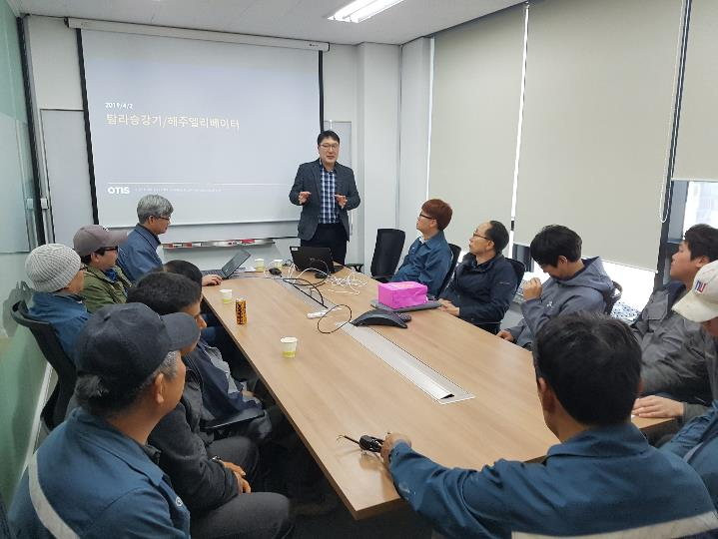




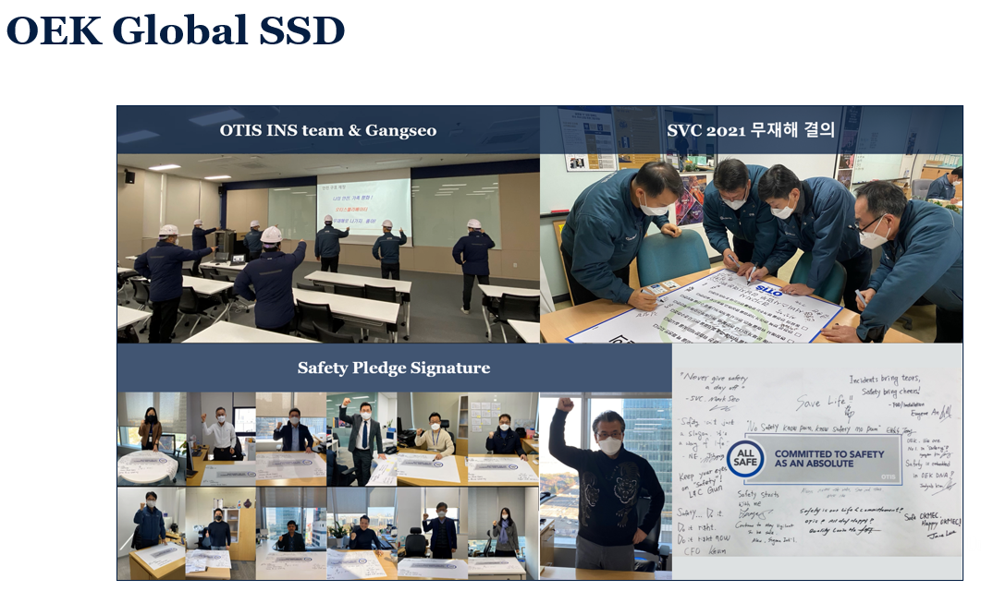




안전성숙도 프로그램
반응적 | 의존적 | 독립적 | 상호보완적
사고조사
안전기준
전사안전회의
작업전위험예방
안전비디오대회
개선활동
기본안전수칙
관리감독자 교육
자체 안전포럼
주간안전회의
작업매뉴얼
안전감사
안전퀴즈대회
안전결의 행사
지사별 평가
Safety Stand Down
고노고 프로세스
가족초청행사
OTIS PROPRIETARY AND CONFIDENTIAL.

Slide 6
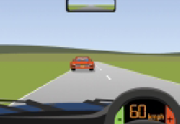
ICE BREAKING
팀장 안전벨트 착용 여부
YES
NO
Ⓐ | Ⓑ
Ⓒ | Ⓓ
안전벨트를 매십시요
YES
NO
OTIS PROPRIETARY AND CONFIDENTIAL.

Slide 7
EH&S MANAGEMENT SYSTEM
Element 01 Policy & Leadership (정책 및 리더십)
Element 02 Organization (조직)
Element 03 Planning (계획)
Element 04 Accountability (책임)
Element 05 Assessment, Prevention & Control (평가, 예방 & 관리)
Element 06 Education and Training (교육 및 훈련)
Element 07 Communications (커뮤니케이션)
Element 08 Rules and Procedures (규칙 및 절차)
Element 09 Inspections and Audits (검사 및 감사)
Element 10 Incident Investigations (사고조사)
Element 11 Documents & Records Management (문서 & 기록관리)
Element 12 Program Evaluation (프로그램 평가)
OTIS PROPRIETARY AND CONFIDENTIAL.

Slide 8
EH&S MANAGEMENT SYSTEM
Overview
확인 프로세스
위험 발견
안전 미팅
기록 확인
안전감사
실적확인
프로그램 평가
안전감사
검사
사고조사
정책
계획
책임
규칙 / 절차
커뮤니케이션
교육 / 훈련
자체 검사
관리 / 개선활동
OTIS PROPRIETARY AND CONFIDENTIAL.

Slide 9

EH&S MANAGEMENT SYSTEM
Policy
OTIS PROPRIETARY AND CONFIDENTIAL.

Slide 10
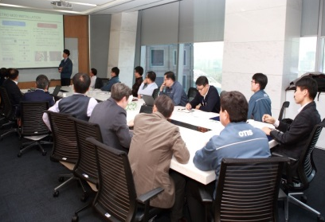
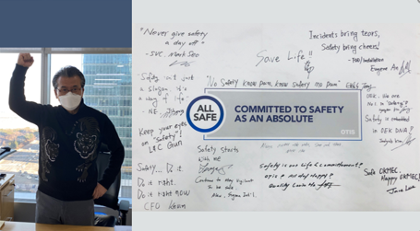
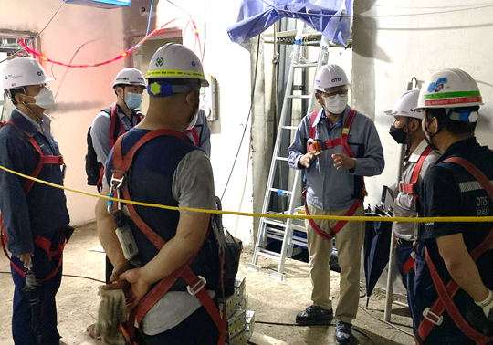
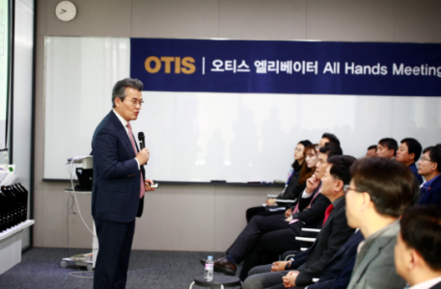
EH&S MANAGEMENT SYSTEM
Leadership
Elevator #3
Normal
Running
TFT 구성
매주 개선활동 보고 1년
격주 개선활동 보고 1년
Elevator #4
Rope
replace
매월 전사 안전 미팅
안전 결의
현장방문 코칭
안전 커뮤니케이션
OTIS PROPRIETARY AND CONFIDENTIAL.
Notes:
사장님 안전활동 설명하면서 관리감독자 안전활동 추가 설명
월 8시간 이상 안전활동
매월 2~3회 현장안전감사활동
팀장은 SV 고노고 활동 검증 활동 20% 이상
2014년 이후 이러한 활동을 시작 할때는 많은 불만이 있었으나 현재는 무리없이 진행

Slide 11
EH&S MANAGEMENT SYSTEM
Organization
President
EH&S HQ
3
Total 17
Service Division
7
FOD/INS Division
7
EH&S Team
EH&S Team
EH&S Auditor
EH&S Auditor
OTIS PROPRIETARY AND CONFIDENTIAL.

Slide 12
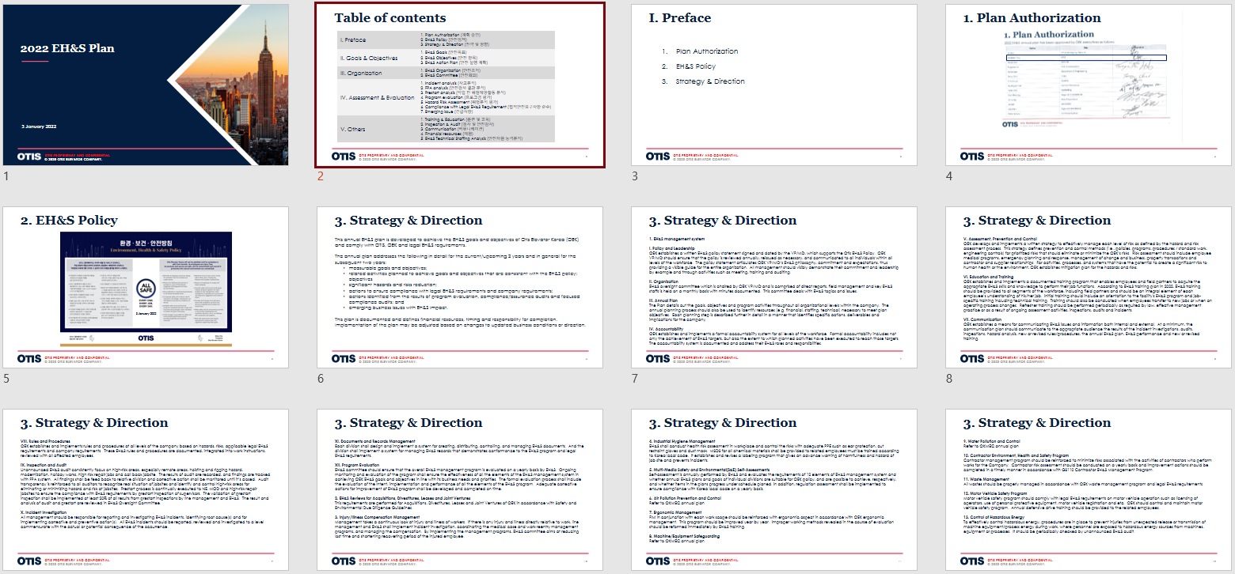
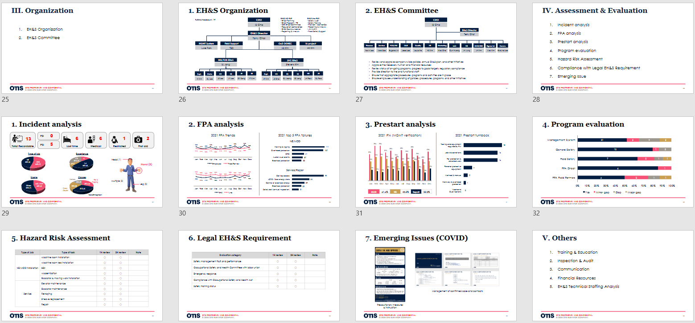
EH&S MANAGEMENT SYSTEM
Planning
I. Preface | 1. Plan Authorization (계획 승인) 2. EH&S Policy (안전정책) 3. Strategy & Direction (전략 및 방향)
II. Goals & Objectives | 1. EH&S Goals (안전목표) 2. EH&S Objectives (안전 항목) 3. EH&S Action Plan (안전 실행 계획)
III. Organization | 1. EH&S Organization (안전조직) 2. EH&S Committee (안전회의)
IV. Assessment & Evaluation | 1. Incident analysis (사고분석) 2. FPA analysis (안전감사 결과 분석) 3. Prestart analysis (작업 전 위험예방활동 분석) 4. Program evaluation (프로그램 평가) 5. Hazard Risk Assessment (위험분석 평가) 6. Compliance with Legal EH&S Requirement (법적안전요구사항 준수) 7. Emerging Issue (긴급사항)
V. Others | 1. Training & Education (훈련 및 교육) 2. Inspection & Audit (검사 및 안전감사) 3. Communication (커뮤니케이션) 4. Financial resources (재원) 5. EH&S Technical Staffing Analysis (안전자원 능력분석)
OTIS PROPRIETARY AND CONFIDENTIAL.

Slide 13
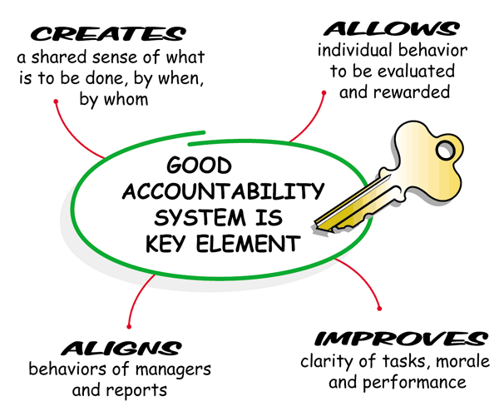
EH&S MANAGEMENT SYSTEM
Accountability
선정
허용
언제 누구에 의해 무엇을 해야 하는지 공유
개인의 행동에 따라 평가되고 보상
조정
향상
관리자 및 보고서 업무
업무, 사기 및 성과 명확성
OTIS PROPRIETARY AND CONFIDENTIAL.

Slide 14
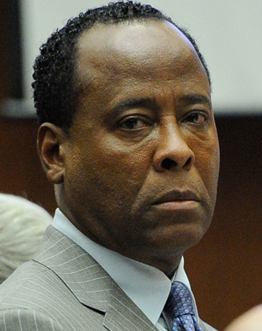
EH&S MANAGEMENT SYSTEM
Accountability
Do you know Dr. Conrad Murray?
OTIS PROPRIETARY AND CONFIDENTIAL.

Slide 15
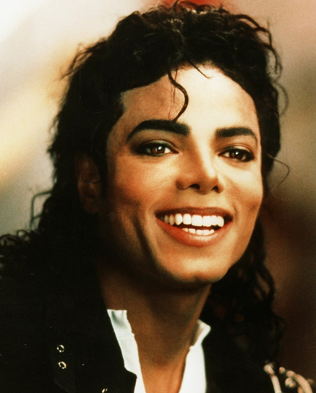
EH&S MANAGEMENT SYSTEM
Accountability
Do you know Michael Jackson?
OTIS PROPRIETARY AND CONFIDENTIAL.

Slide 16

EH&S MANAGEMENT SYSTEM
Accountability
Why Michael Jackson died?
Jackson's death
on June 25, 2009,
was caused by
"acute propofol intoxication"
OTIS PROPRIETARY AND CONFIDENTIAL.

Slide 17
EH&S MANAGEMENT SYSTEM
Accountability
What was Dr. Conrad Murray’s responsibility?
Murray served as Jackson's personal physician as Jackson prepared for his comeback concerts, with Murray giving him the surgical anesthetic propofol to help him sleep nearly every night for the last two months of his life.
OTIS PROPRIETARY AND CONFIDENTIAL.

Slide 18
EH&S MANAGEMENT SYSTEM
Accountability
Who was responsible for Michael Jackson's sudden death?
OTIS PROPRIETARY AND CONFIDENTIAL.

Slide 19
EH&S MANAGEMENT SYSTEM
Accountability
Outcome in the court?
On November 29, 2011, Murray was given the maximum sentence of four years in prison.
Prosecutor said "This is not a crime involving a mistake of judgment..... This was a crime where the end result was the death of a human being."
OTIS PROPRIETARY AND CONFIDENTIAL.

Slide 20
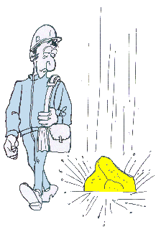
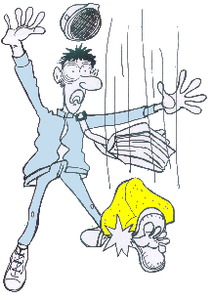
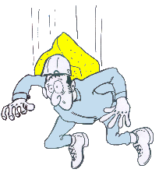
EH&S MANAGEMENT SYSTEM
Assessment, Prevention & Control
아차사고
근로손실 사고
중대재해 사고
가장 중요한 것은 사고가 얼마나 심각한지가 아니라 예방하는 것이다.
OTIS PROPRIETARY AND CONFIDENTIAL.

Slide 21

EH&S MANAGEMENT SYSTEM
Assessment, Prevention & Control
1
사망사고
30
중대재해
300
근로손실
3,000
아차사고
Potential Hazards
30,000
불안전한 행동 및 환경
From: A.W. Heinrich, Industrial Accident Prevention: A Scientific Approach, McGraw Hill, NY 1931
OTIS PROPRIETARY AND CONFIDENTIAL.

Slide 22


EH&S MANAGEMENT SYSTEM
Assessment, Prevention & Control
Hazard
Incident
Risk
Poorly managed or
unmanaged hazards
Unsafe acts and unsafe conditions
OTIS PROPRIETARY AND CONFIDENTIAL.

Slide 23

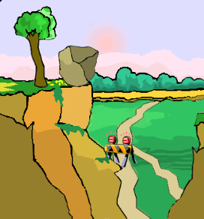

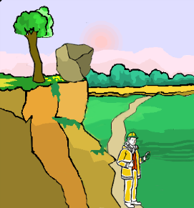
EH&S MANAGEMENT SYSTEM
Assessment, Prevention & Control
제거
PREVENT OR DESIGN OUT THE HAZARD
LONG-TERM SOLUTION
  Use the management system (안전 매니지먼트 시스템 사용)
  Remove (제거)
  Replace (교체)
  Change the process or procedure
CONTROL THE HAZARD—”QUICK FIX” PHYSICAL CONTROL
  Put up a barrier (차폐판)
  PPE (개인안전장비)
  Safeguard (보호장치)
  Containment (방지/억제)
HUMAN CONTROL
  Add rules, procedures, and training
예방
제어
OTIS PROPRIETARY AND CONFIDENTIAL.

Slide 24
EH&S MANAGEMENT SYSTEM
Assessment, Prevention & Control
Monitor Progress
Identify Risks
Oversight meeting
Documentation
Management Validation
Performance (metrics)
Assessment
Program evaluation
Assurance reviews
Inspections
Incident investigations
Policy
Planning
Accountability
Rules and Procedures
Communication
Training
Self Inspections
Control / Mitigate
Risks
OTIS PROPRIETARY AND CONFIDENTIAL.

Slide 25
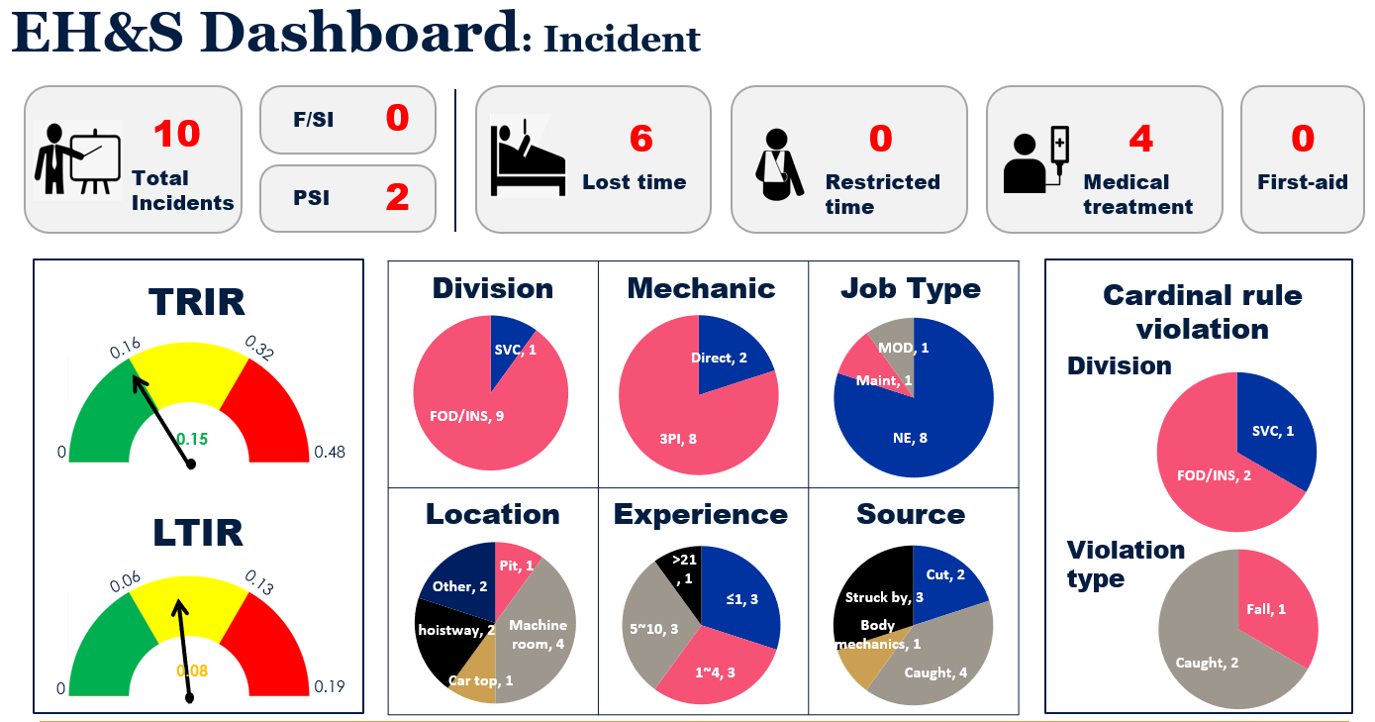
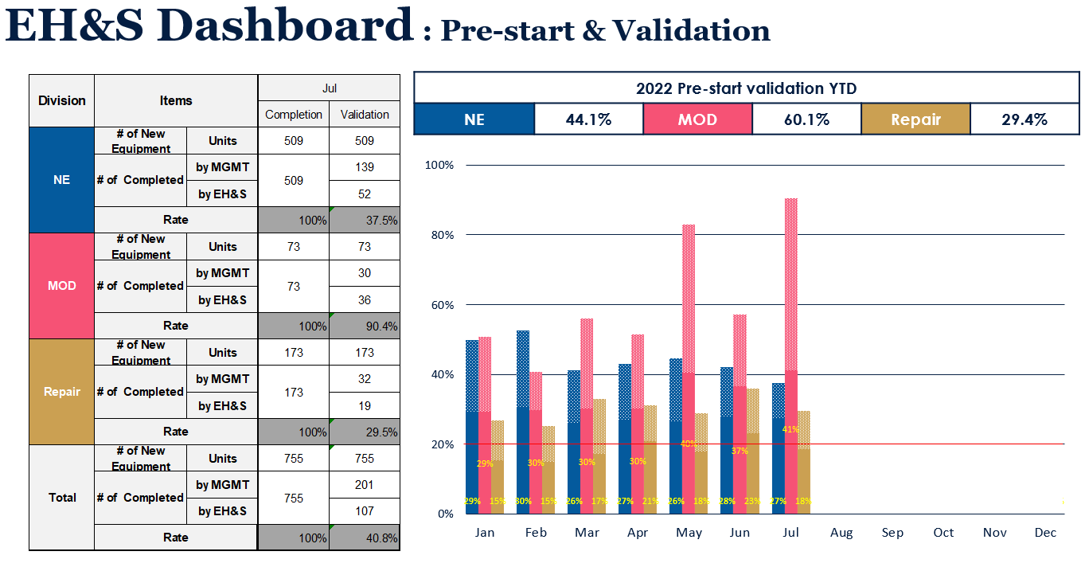
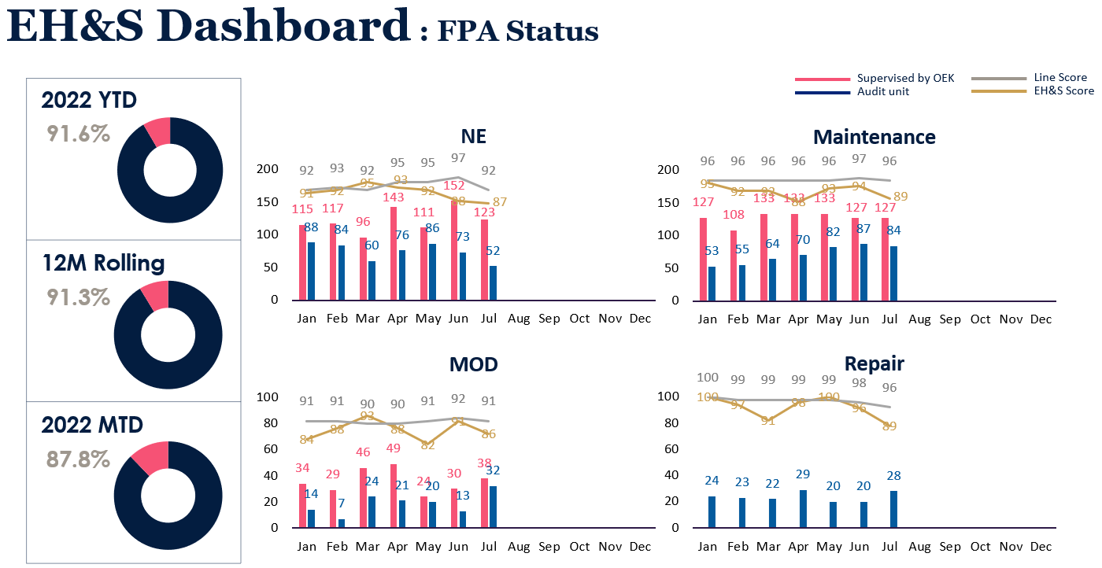
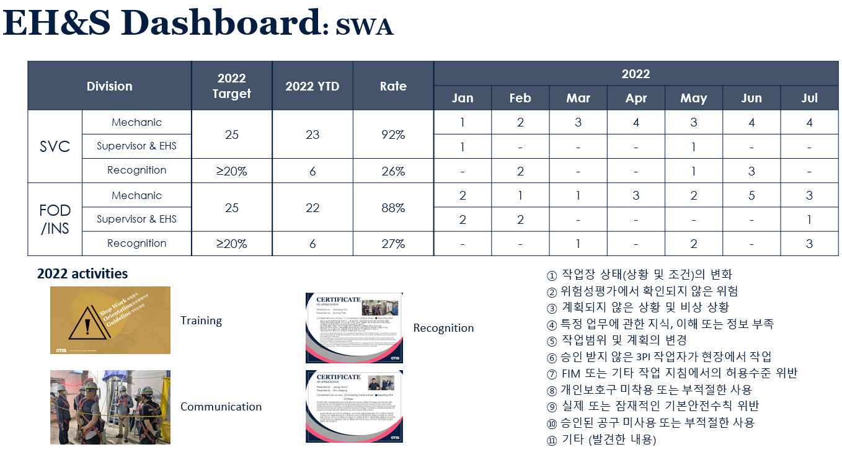
EH&S MANAGEMENT SYSTEM
Assessment, Prevention & Control
OTIS PROPRIETARY AND CONFIDENTIAL.

Slide 26
EH&S MANAGEMENT SYSTEM
Education & Training
New Comer
Mechanic
Manager & Supervisor
Monthly Safety Training
(2hrs / Month)
Essential Refresher Training
New Comer Training
(8hrs / Once)
Cardinal Safety Rules
WWJSSS
FPA
Hazard Scan
Learn & Live
Job Hazard Analysis
Hoisting & Rigging
Safety Dilemma
Go/No-Go Process
(2hrs / Year)
Subcon Key Requirement
(2hrs / Year)
FPA Auditor
(24hrs / Once)
: Delivered by EHS
MELT
(16hrs / Once)
: Delivered by Line Mgt.
OTIS PROPRIETARY AND CONFIDENTIAL.

Slide 27

EH&S MANAGEMENT SYSTEM
Communications
OTIS PROPRIETARY AND CONFIDENTIAL.

Slide 28
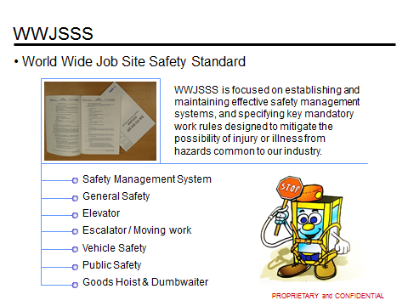
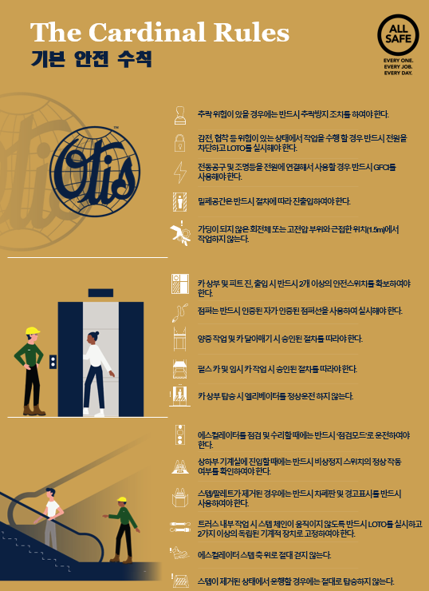
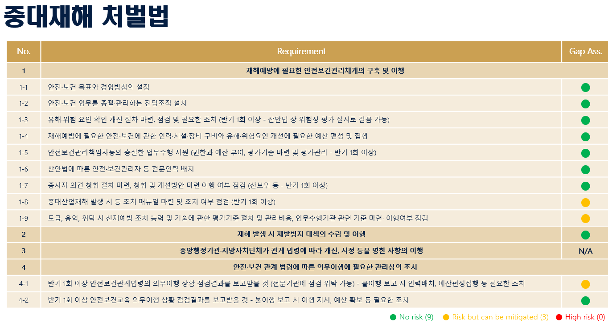
EH&S MANAGEMENT SYSTEM
Rules & Procedures
OTIS PROPRIETARY AND CONFIDENTIAL.

Slide 29
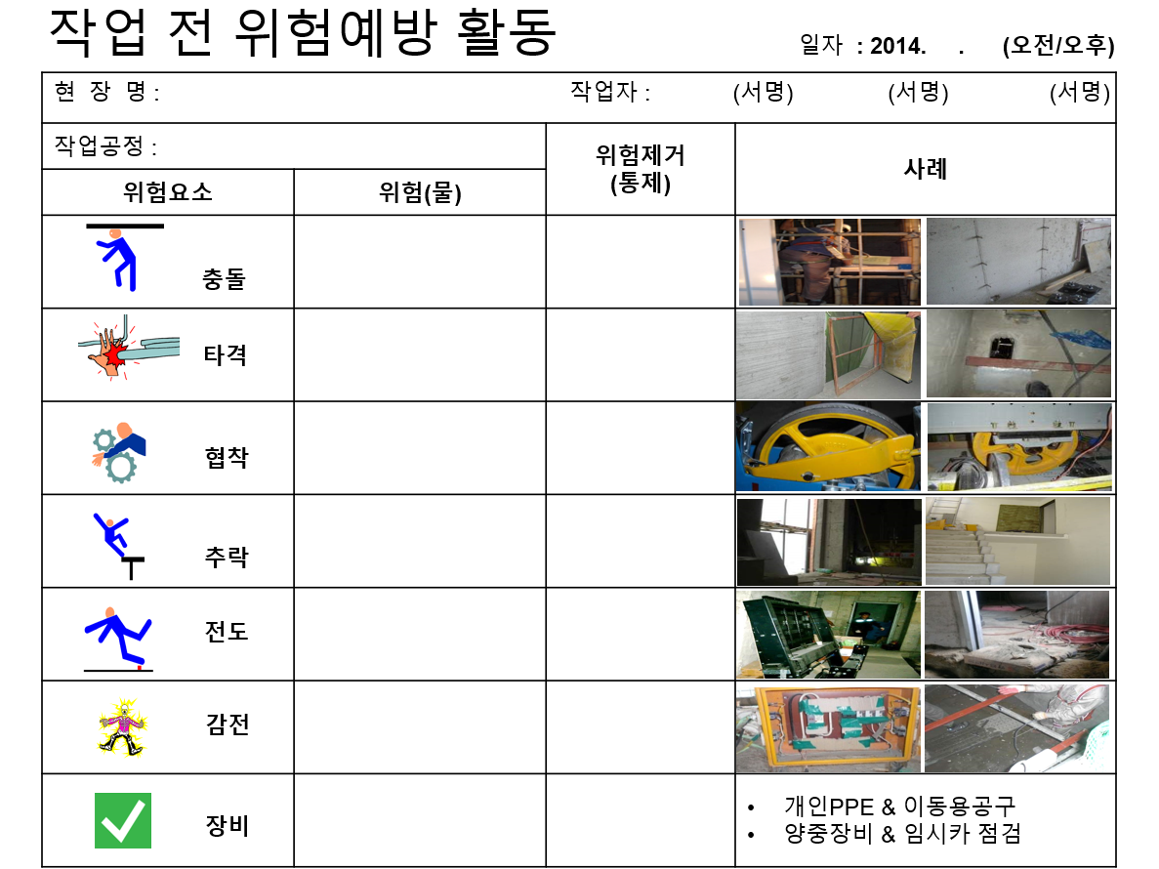
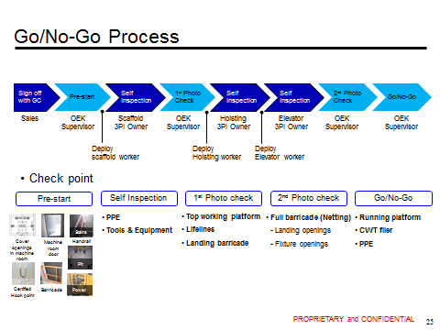
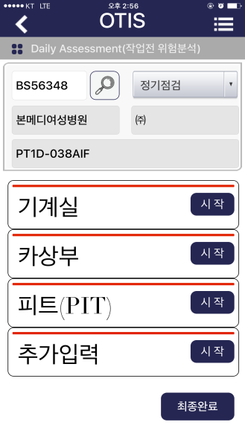
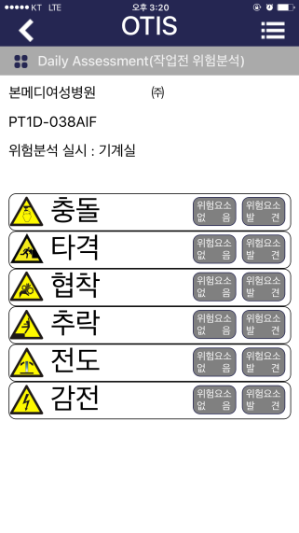
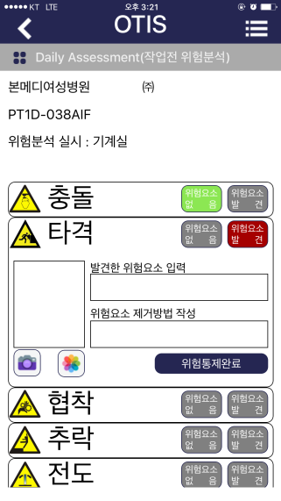
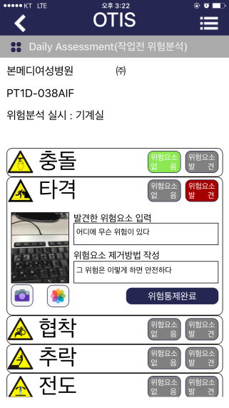
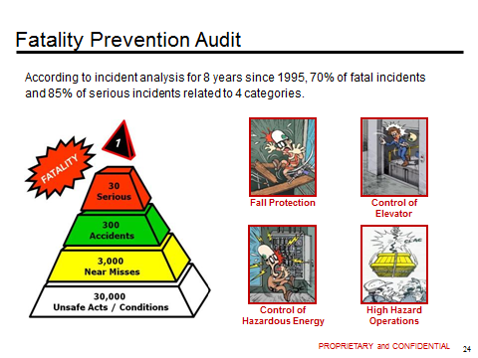
EH&S MANAGEMENT SYSTEM
Inspection & Audit
① 작업자
② 관리자
③ 안전감사자
OTIS PROPRIETARY AND CONFIDENTIAL.

Slide 30
EH&S MANAGEMENT SYSTEM
Incident Investigations
Organisational and System Factors
Task and Environmental Conditions
Individual and Team Actions
Absent or Failed Defences
TASK
INJURY
Latent Conditions
Active Failures
OTIS PROPRIETARY AND CONFIDENTIAL.

Slide 31
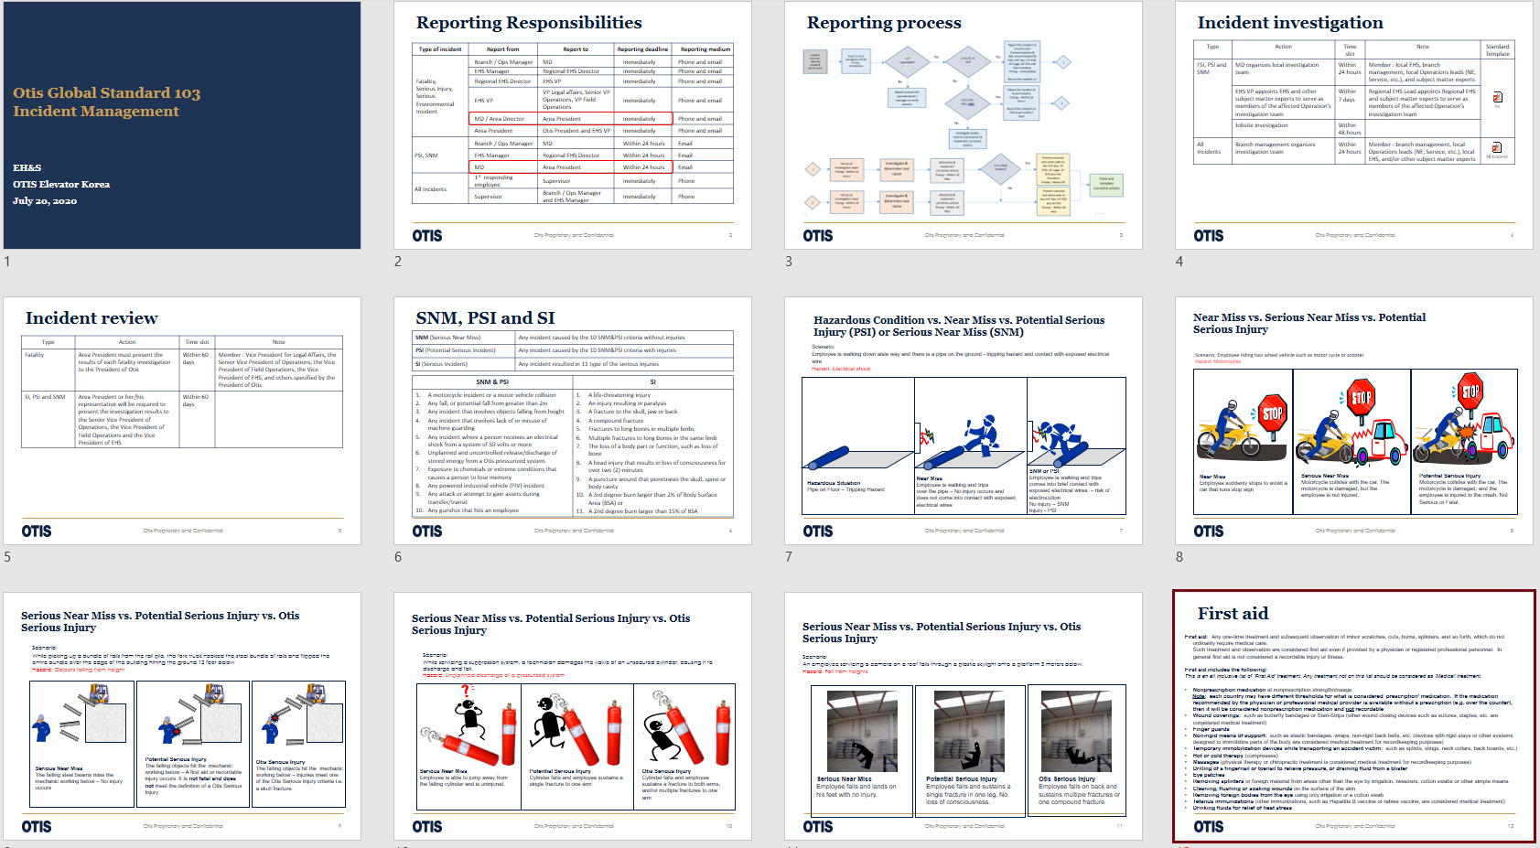
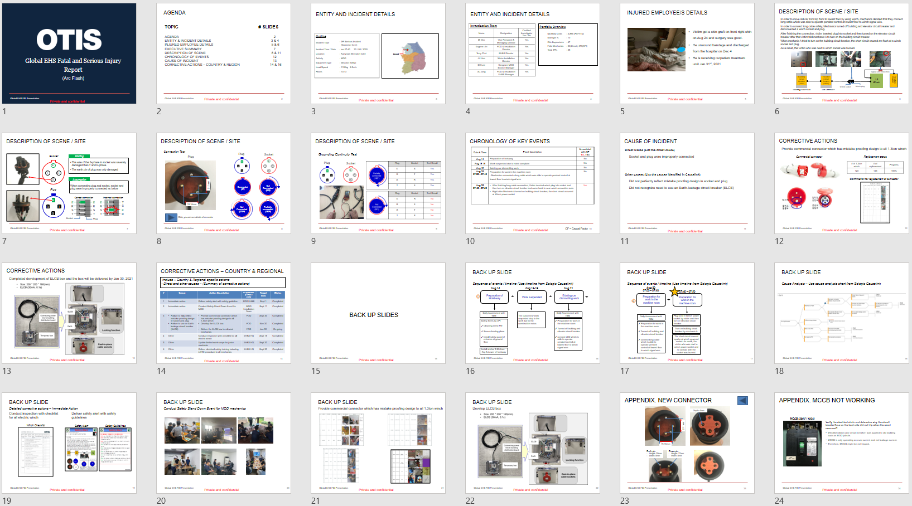
EH&S MANAGEMENT SYSTEM
Incident Investigations
사고보고 프로세스
사고조사 보고서
OTIS PROPRIETARY AND CONFIDENTIAL.

Slide 32
EH&S MANAGEMENT SYSTEM
Documents & Records Management
Implement a system for creating, Distributing, controlling and managing documents and records. Define:
  Documents/records to be retained
  Responsibility for records maintenance
  Retention and archival periods
  File locations
  Security and confidentiality system
  Procedure for responding to inquires
  for information
OTIS PROPRIETARY AND CONFIDENTIAL.

Slide 33
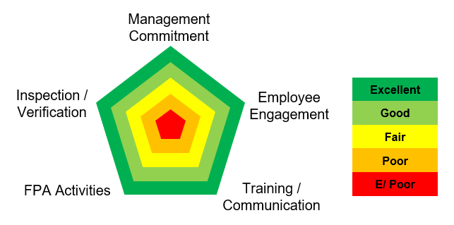
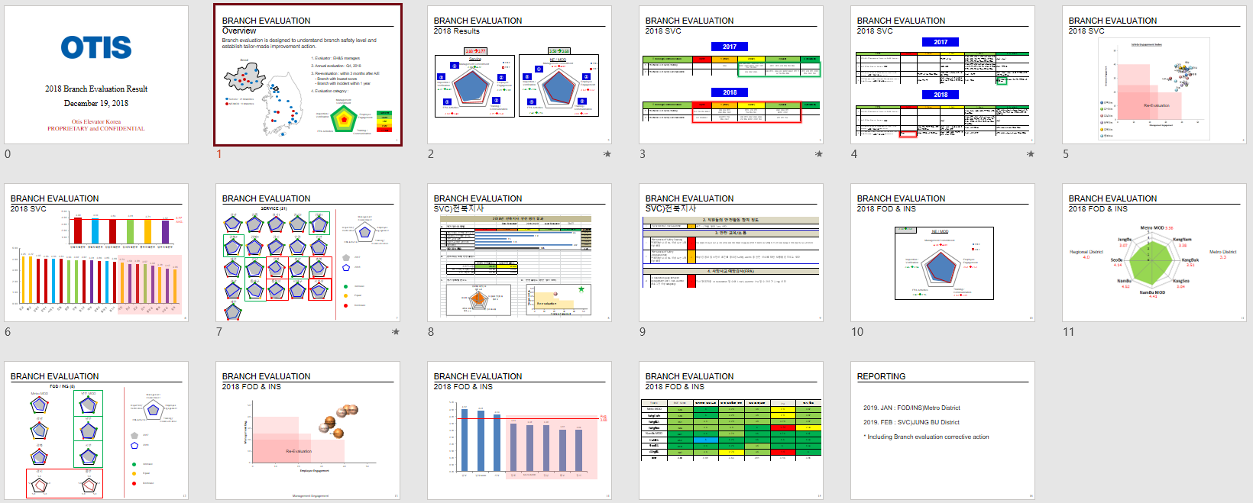
EH&S MANAGEMENT SYSTEM
Program Evaluation
OTIS PROPRIETARY AND CONFIDENTIAL.

Slide 34
BEHAVIOR BASED SAFETY
OTIS PROPRIETARY AND CONFIDENTIAL.

Slide 35
BEHAVIOR BASED SAFETY
Safety Performance
100% safe
Behavior
Management Systems
50%
Compliance
Time
OTIS PROPRIETARY AND CONFIDENTIAL.

Slide 36
BEHAVIOR BASED SAFETY
Safety Performance
Management System,
Programes and procedures
Incidents /
Accidents
Behavior/Person
Time
OTIS PROPRIETARY AND CONFIDENTIAL.

Slide 37
BEHAVIOR BASED SAFETY
Safety Performance
Consequence of risks taken
Certain
Soon
Significant
Incident
(not all the times)
Incident
Risks Taken
Lucky
Behavior
No Risks
Safe
OTIS PROPRIETARY AND CONFIDENTIAL.

Slide 38
안전문화
OTIS PROPRIETARY AND CONFIDENTIAL.

Slide 39
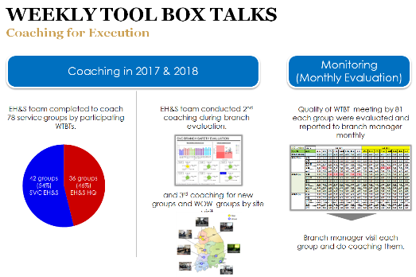
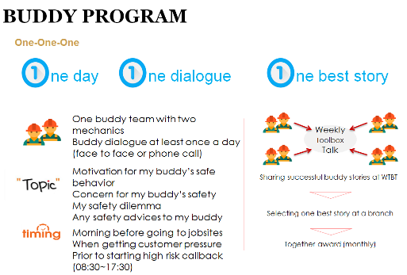
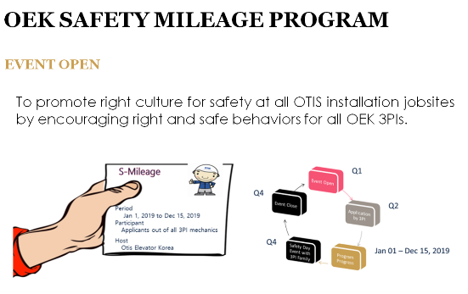
Safety culture
Employee Engagement
WTBT
Buddy Program
Safety mileage
Unsafe behaviours and conditions
Near miss
Group discussion
One buddy team with two mechanics
My safety dilemma
When getting customer pressure
3PI’s field professionals
OEK Welfare Shopping Mall
Individual safety performance
OTIS PROPRIETARY AND CONFIDENTIAL.

Slide 40
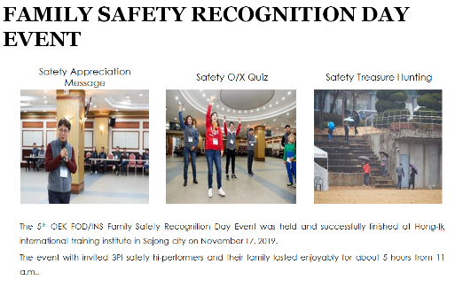
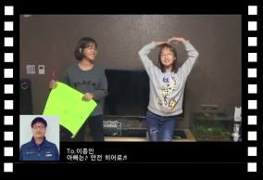
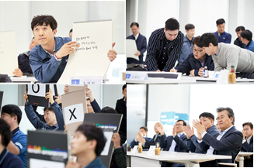

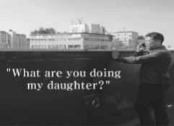
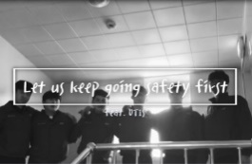


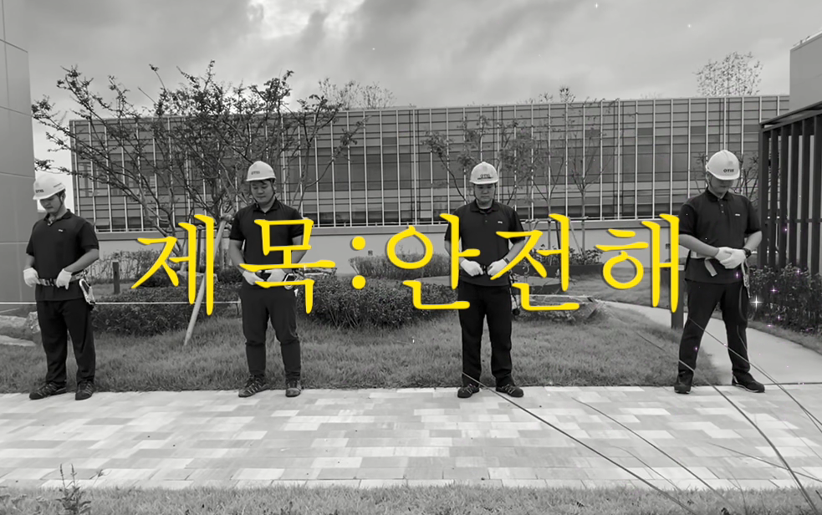
Safety culture
Employee Engagement
8th Family Day
7th Safety Video
8th Golden Bell Quiz
2016
2017
2018
2019
2020
2021
OTIS PROPRIETARY AND CONFIDENTIAL.

Slide 41
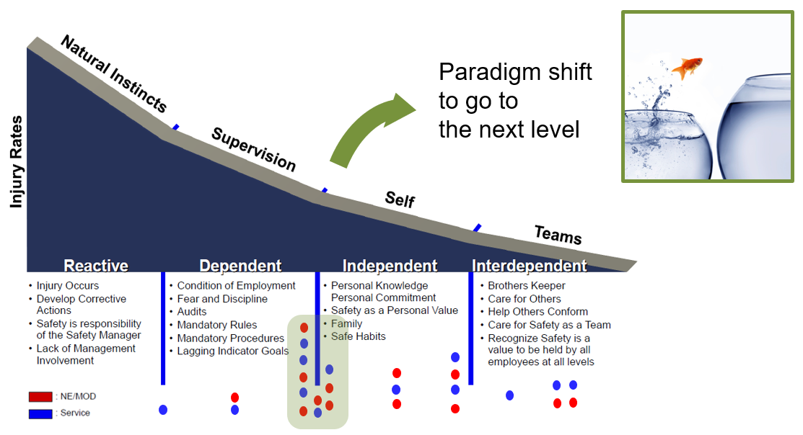

Safety value
경영자 및 관리감독자 안전 리더십
안전 매니지먼트 시스템 구축
안전문화를 통한 직원들의 안전 구축
From | To
Priority | Value
Reactive | Proactive
Result | Behavior
Fault | Fact
Rule | Accountability
OTIS PROPRIETARY AND CONFIDENTIAL.

